Slide 1

🚗 Automobile Sales & Market Insights Report
Comprehensive Analysis (2003–2005)
Covering: Sales & Customer Analysis • Forecasting • Product Performance • Stock & Orders • Pricing Strategy
Prepared by: Santhosh V

Slide 2
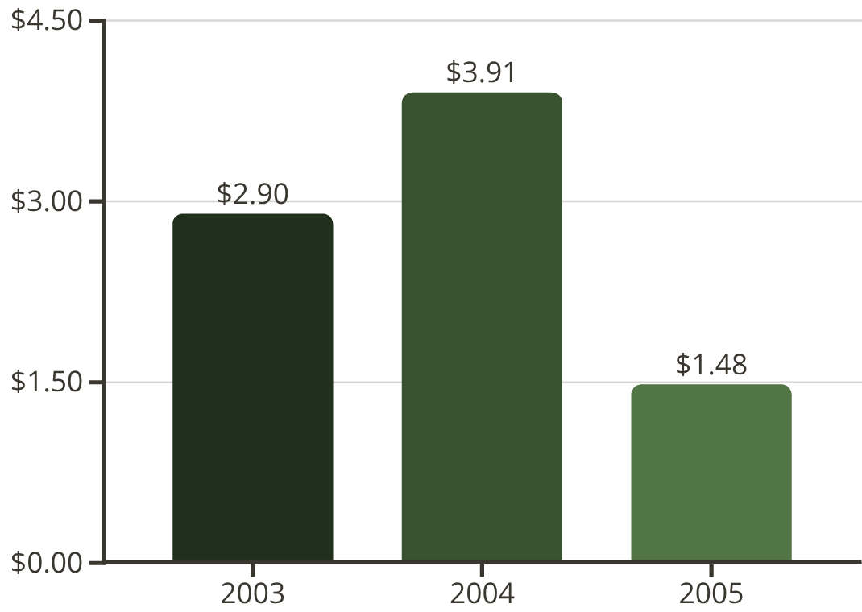
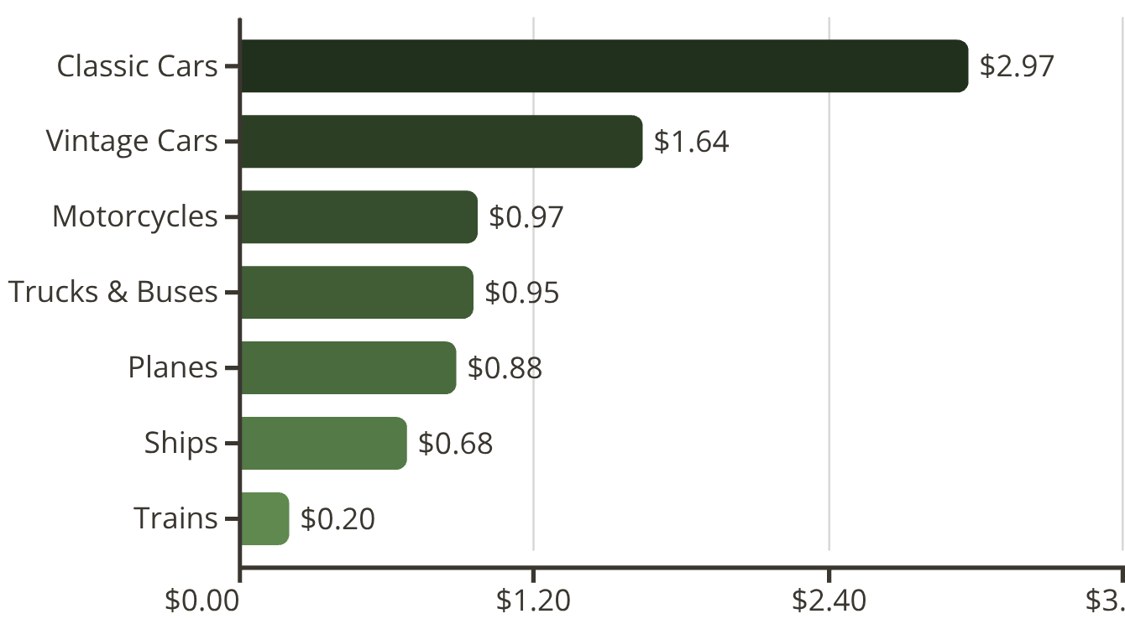

Sales & Customer Analysis Overview
Our analysis reveals significant growth patterns and market concentration across the 2003-2005 period. Sales peaked dramatically in 2004 at $3.91M before declining in 2005, while customer concentration presents both opportunities and risks.
Sales Performance by Year
Sales by Product Category
Key Insight
📈 Sales peaked at $3.91M in 2004, representing 35% growth from 2003
📉 Sharp decline to $1.48M in 2005 signals market challenges

Slide 3
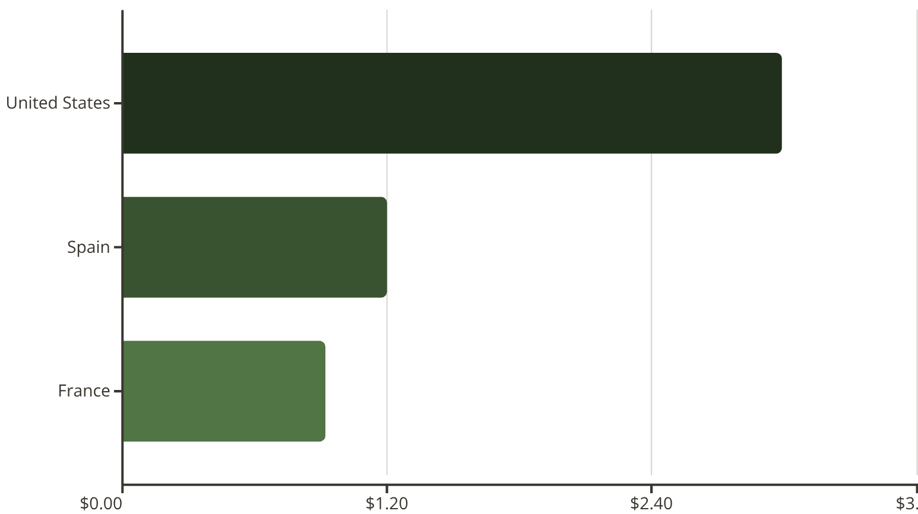
Geographic & Customer Distribution
Understanding market concentration and customer dependency is crucial for strategic planning and risk management, highlighting both strengths and areas for growth.
Top Countries by Sales
Key Customer Insights
Top Customer: Euro Shopping Channel leads with $0.76M in sales, representing a significant portion of our revenue.
Market Concentration: A heavy reliance on a few major customers indicates potential risk and the need for diversification.
Deal Distribution: Medium-sized deals currently dominate, accounting for 60% of total sales ($4.96M).
Growth Opportunity: There is significant potential to expand our customer base, particularly within the Spanish and French markets.

Slide 4
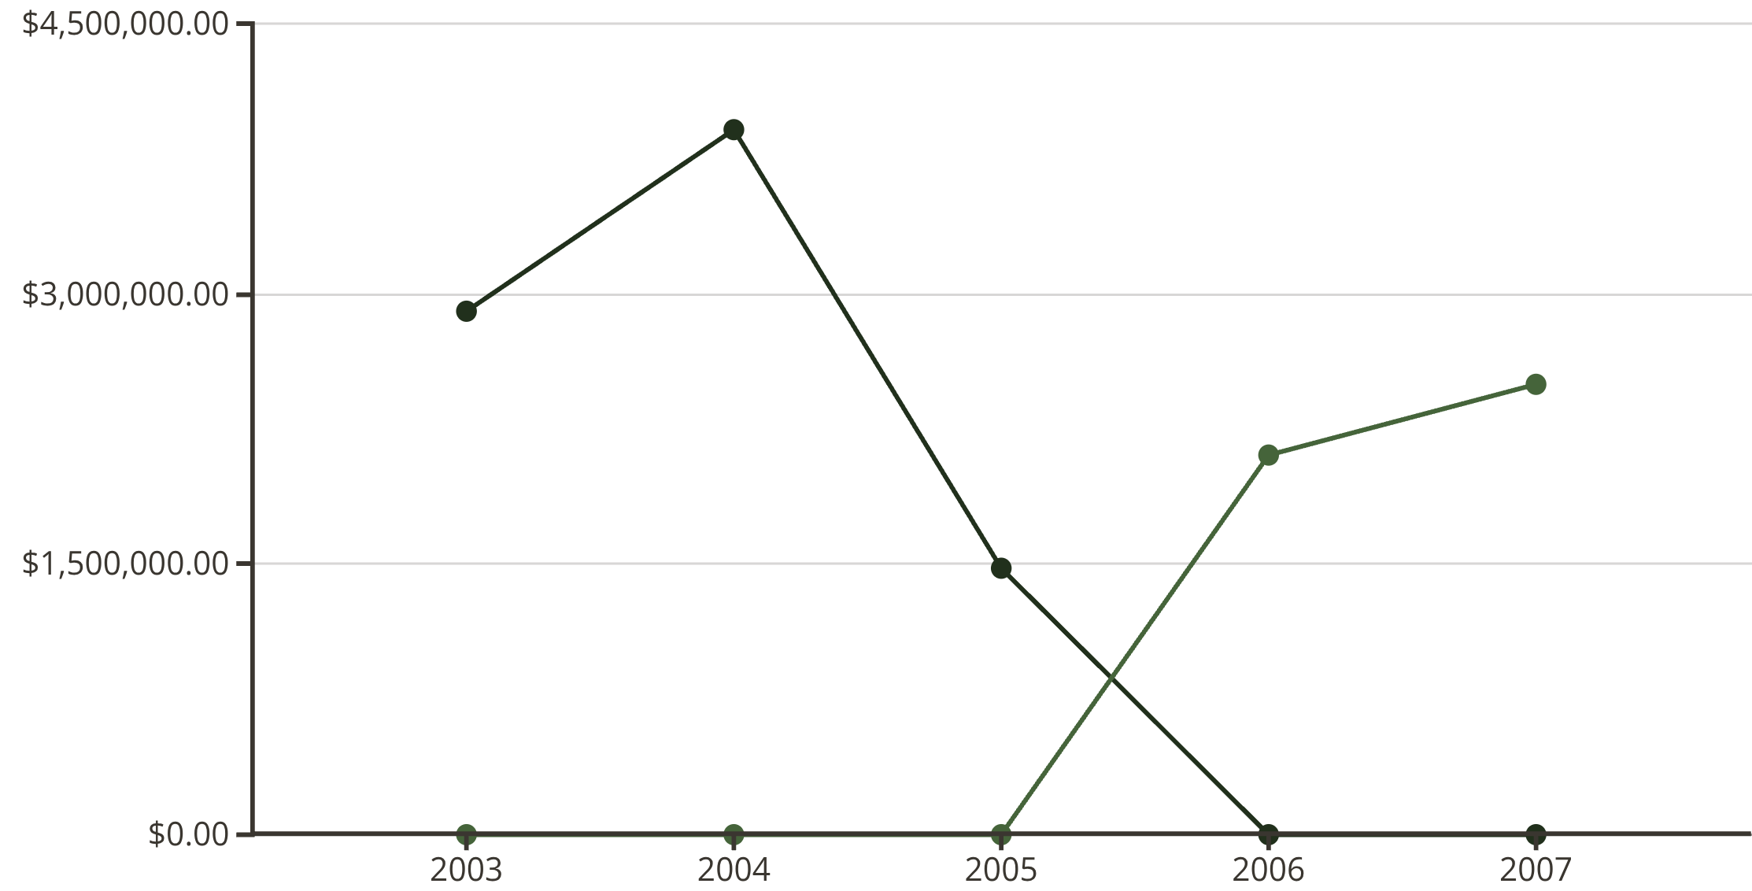
Sales Forecasting: Road to Recovery
Actual vs Forecasted Sales (2003–2007)
Actual Sales
Forecasted Sales
📈 2006 Outlook
📊 2007 Target
🎯 Key Drivers
$2.10M projected
$2.50M projected
Classic & Vintage Cars leading growth
42% recovery from 2005 levels
Continued upward trajectory
US market stabilisation with 60 %

Slide 5
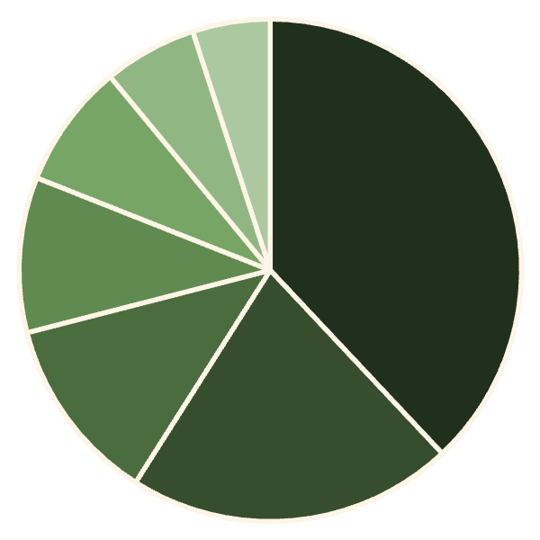
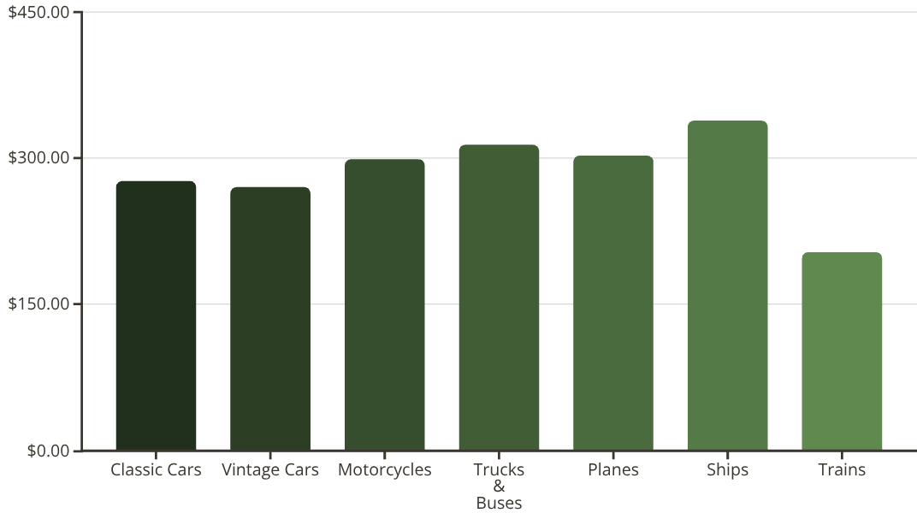
Product Performance Deep Dive
Classic Cars
Vintage Cars
Motorcycles
$2.97M revenue
$1.64M revenue
$971K revenue
10,703 units • $277 avg price • 38% market share
6,098 units • $270 avg price • 21% market share
3,245 units • $299 avg price • 12% market share
Classic Cars
Vintage Cars
Motorcycles
Trucks & Buses
Planes
Ships
Trains
Market Share Distribution
Average Unit Price by Product Line
$314
$303
70%
Trucks & Buses
Planes
Top 3 Lines
Highest unit price
Premium pricing tier
Share of total revenue

Slide 6

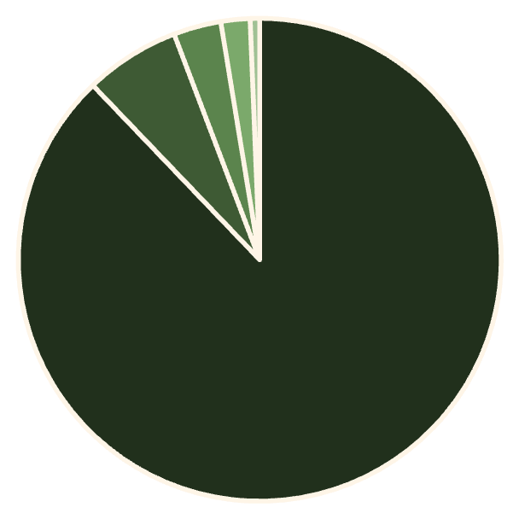


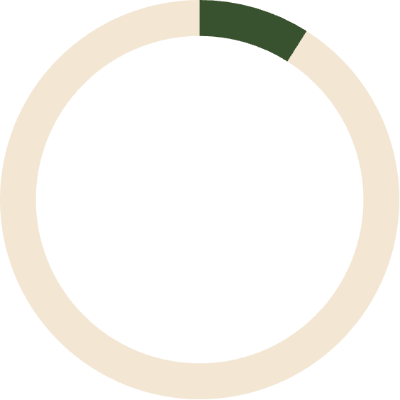
Stock & Order Analysis
Order Status Distribution
✅ Strong Fulfilment Rate
88% orders successfully shipped
Shipped
Only 6% cancellation rate demonstrates operational excellence
Cancelled
3% on hold requiring attention
On Hold
In Process
Other
Deal Size Distribution
60%
31%
9%
Medium Deals
Small Deals
Large Deals
$4.96M • 1,490 orders • Core business driver
$2.59M • 1,085 orders • Volume play
$739K • 248 orders • Premium segment

Slide 7
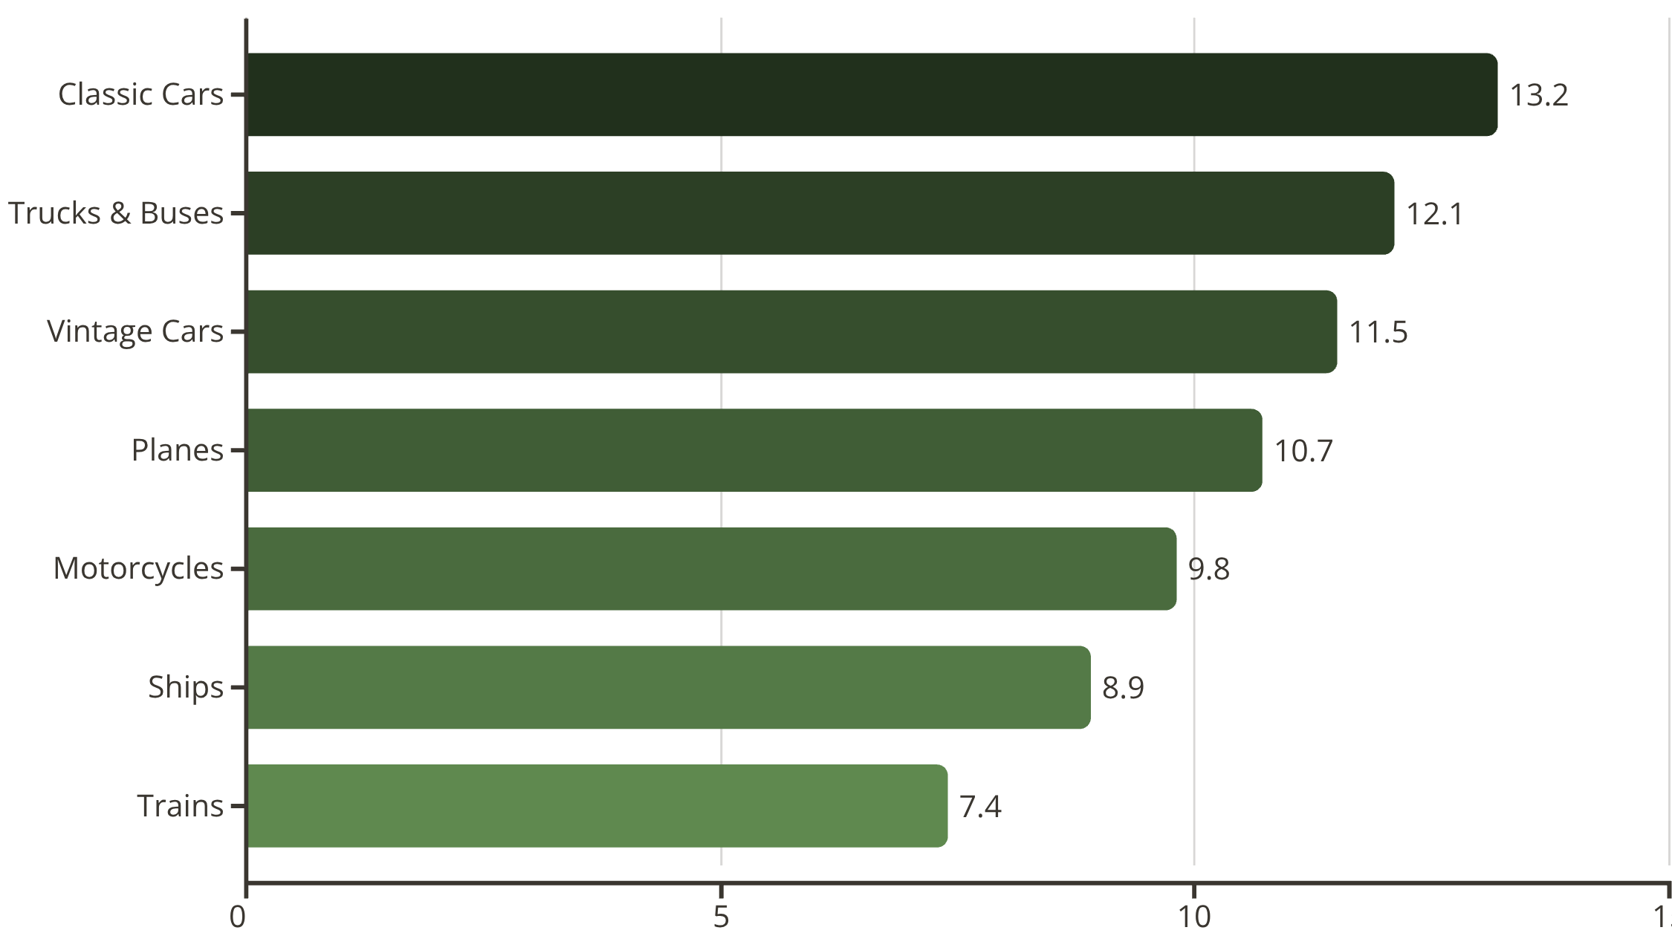



Pricing Strategy & Discount Analysis
Average Discount by Product Line
Sweet Spot
Deal Size Impact
MSRP vs Actual
10–15% discount range drives 37% of total sales ($3.1M) for Classiccars
Larger deals receive 14%+ discounts, boosting volume but pressuring margins
Average selling prices consistently 10–15% below MSRP across all lines

Slide 8

Strategic Recommendations
01
Sales Growth & Market Expansion
Reduce dependency on top customers • Broaden base in Spain & France • Launch new products in underperforming lines (Trains, Ships)
02
Customer & Deal Strategy
Implement loyalty programmes • Address revenue concentration risks • Optimise medium-deal focus while protecting margins on large deals
03
Stock & Operations Excellence
Investigate 6% cancellation causes • Strengthen demand forecasting • Leverage seasonality for inventory planning
04
Pricing Optimisation
Maintain 10–15% discount standard • Reduce excessive discounting on large deals • Value-based pricing for premium lines

Slide 9




Key Business Insights
A comprehensive analysis finding across sales trends, market concentration, product performance variations, and pricing optimization opportunities that present both challenges and growth potential for sustainable business expansion.
Sales Growth Pattern
Product Dominance
Market Concentration Risk
Optimal Deal Structure
Sales peaked in 2004 at $3.91M but saw recovery potential with strategic adjustments and market expansion.
Classic Cars and Vintage Cars control the backbone of revenue, contributing nearly 60% of total sales.
Medium deals with 10-15% discounting deliver optimal balance of volume and profitability.
Heavy reliance on few customers and US market presents risks requiring diversification strategies for sustainable growth.

Slide 10

Executive Summary
Key Takeaways
📊 Market Position
Sales peaked at $3.91M in 2004 • Recovery forecasted to $2.5M by 2007 • Classic & Vintage Cars remain revenue backbone
⚠️ Risk Factors
Heavy reliance on few customers • 60% sales from US market • Top customer contributes 9% of revenue
💡 Growth Drivers
Medium deals with 10–15% discounting optimal • 88% fulfilment rate strong • Geographic expansion opportunity in Europe
🎯 Path Forward
Diversify customer base • Optimise discount strategy • Improve stock management • Expand product portfolio strategically
"Future growth lies in expanding our customer base, optimising pricing strategies, and strengthening operational excellence across all product lines."

